Slide 1
The practical use of ASM in the industry
mvanta@bitdefender.com

Slide 2
What’s next?
NASM: the preprocesor
  conditional assembly: %if, %ifdef, %ifndef, %ifidn, ...
  macros
Reverse engineering
System programming:
  CPU modes of operation: real, protected, virtualization
  16 and 64 bits code, control instructions
  memory management and memory protection: segmentation, paging, VT-d/IOMMU
  exception and interrupt handling, inter-CPU communication, synchronization and resource sharing
Other instruction sets: FPU, SSE, AVX, ...
Compilers, memory & speed optimizations
Low-level interaction with the O.S. (MS. Windows, Linux etc...)
Interacting with external devices:
  buses, ports, memory mappings, physical address space management, interrupt vectors
  writing device driver

Slide 3
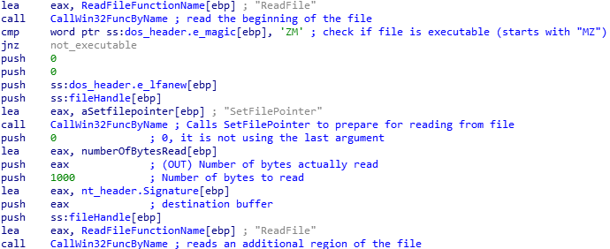
ASM usage scenarios
Common use cases, tailored for usual Bitdefender activities
  Reverse engineering: detailed analysis of a software component, instruction by instruction, for revealing information about how it was made and what possible behaviors it could manifest.
    Used for software defects analysis (debugging), uncovering incompatibilities and problematic interactions between applications and/or the O.S.
      Often the studied code is of foreign origins, unknown in purpose or undocumented
    Used for deciding whether or not an application is malicious in its nature
      Malware? What would the remediation method be? How could it be detected?
A small fragment from the analysis and documentation of the actions performed by
a malicious program (a file infector).
The names (labels) and the comments have manually been added by a security specialist.
(feat. IDA – the Interactive Disassembler)

Slide 4
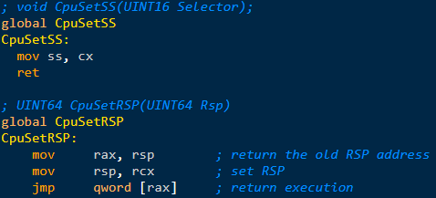
ASM usage scenarios
Common use cases, tailored for usual Bitdefender activities
  As a fallback to the shortcomings of using high-level languages
    Very short ASM subroutines that expose CPU features that are otherwise inaccessible when programming in a high-level languages.
      ASM only fills in the existing gaps, it is not a replacement!
64-bit code!
- al/ax/eax/rax: 8/16/32/64 bit registers
- The X64 call convention:
- RCX, RDX, R8, R9: first 4 arguments
- additional arguments use the stack (reversed)
- the caller does the cleanup
(sample from the Bitdefender Napoca HV)

Slide 5
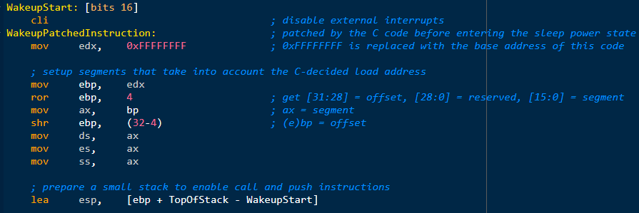
ASM usage scenarios
  Overcoming the O.S. imposed limitations
    Writing bootloaders or operating systems
    Writing 16/32/64 bit mixed code or any code that runs outside of an O.S.
    Enabling auto-generated or self-modifiable code and hot/patching techniques (used by Bitdefender to monitor the behavior of all programs for suspicious activities)
- code that runs (without an OS being present) right when the PC wakes up from sleep
- code patching: the accompanying C module overwrites the mov constant (the imm32)
- [bits16] while it’s actually a part of a 64-bit program!
- No O.S. present to stop this code from setting up it’s own segments and own stack!

Slide 6
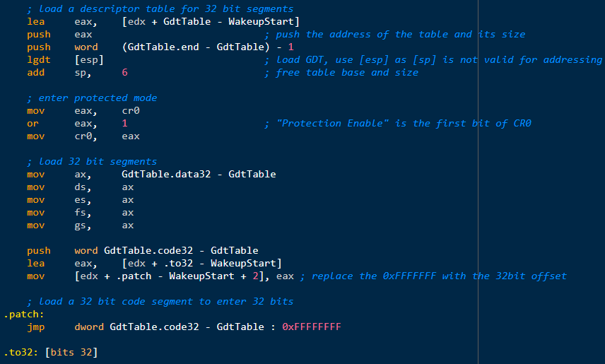
ASM usage scenarios
  Overcoming the O.S. imposed limitations
(continuation)
- setting-up segments, activating the protected mode and switching to 32-bit code execution
- there’s also a trivial instance of self-modifying code (the .patch instruction is overwritten)

Slide 7
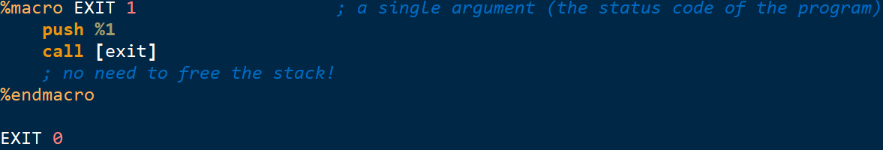
Using abstractions to increase productivity
Macros
    A block of ASM source code (text) that:
      Has a name and (optionally) a list of arguments
      Can be referred by its name & arguments for repeated reuse
      The preprocessor performs a textual search&replace for the name and arguments with the associated textual body
        The parameters allow the copies (instances) to be individually customized.
Two types of macros:
  Single-line – defines a constant or formulae that can be reused inside / as part of various instructions
    What about the “x” from the macro body, doesn’t it need parentheses too? Why?
  Multi-line – a sequence of instructions that can be used together like a single program instruction!
    They allow variable number of arguments
      Therefore, names for the arguments can’t be defined and are instead referred by special symbols: %1, %2, %3 etc…
      %0 tells how many arguments have actually been given at the time of invocation
      M, M-N, M-*, M+, M-N+, ...

Slide 8
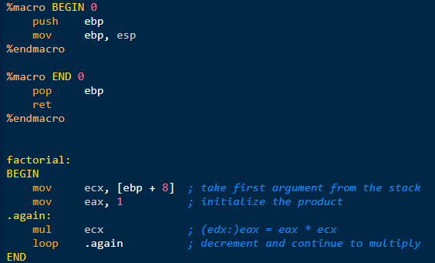
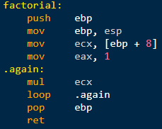
Using abstractions to increase productivity
Macros

Slide 9
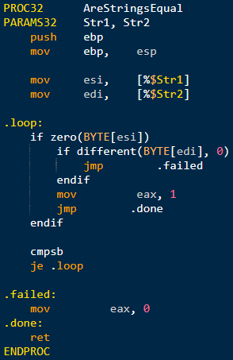
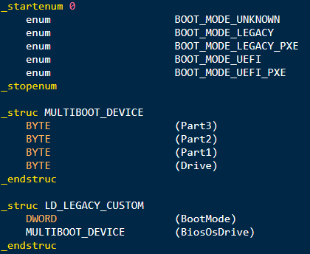
Using abstractions to increase productivity
Macros
  Nasm offers advanced facilities for repetition, cooperation and nesting
  They allow defining abstractions usually associated with high-level languages:
    Subroutines
    Conditional and repetitive blocks
    Data structures, enumerations
  Warning: macros are prone to errors that are hard to understand and fix!
    They must be used with caution and only if the benefits clearly justify the risks!
    Extensive knowledge and experience is needed for avoiding the (too) many pitfalls!

Slide 10
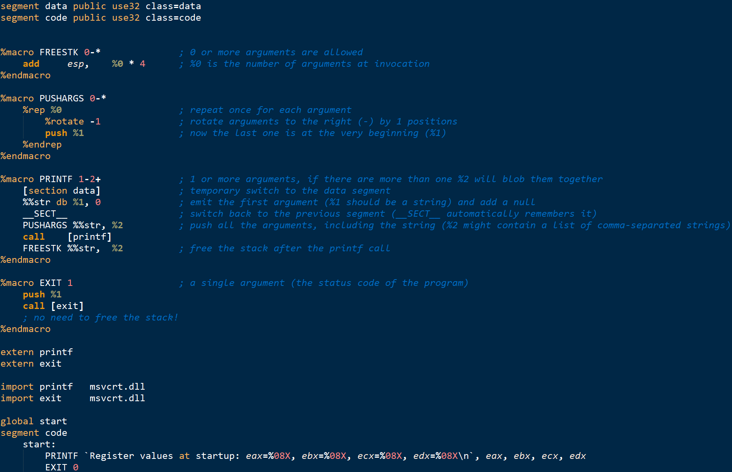
Using abstractions to increase productivity

Slide 11
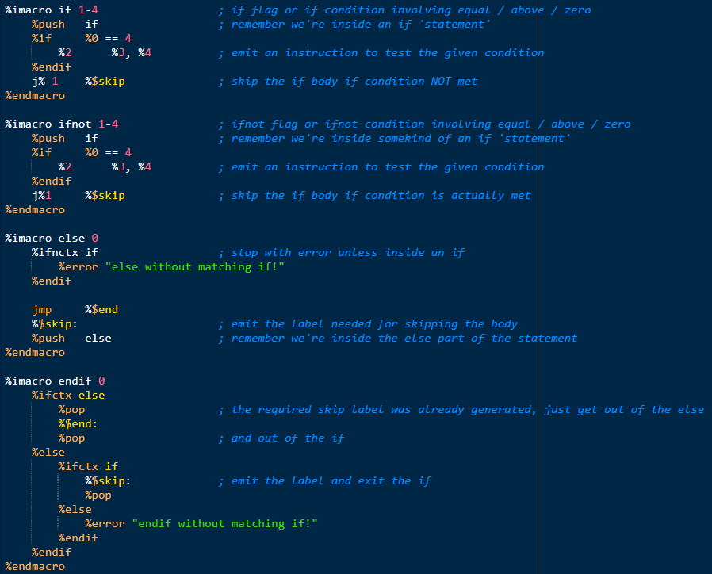
Using abstractions to increase productivity
Macros
  Non-trivial macros are difficult to write correctly, hard to read and to maintain
Thoroughly documented, and yet,
it still looks alien and indecipherable

